Slide 1
Teaching Network:
Teaching with Meaning

Slide 2
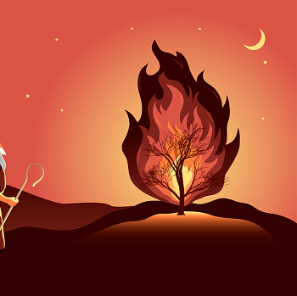
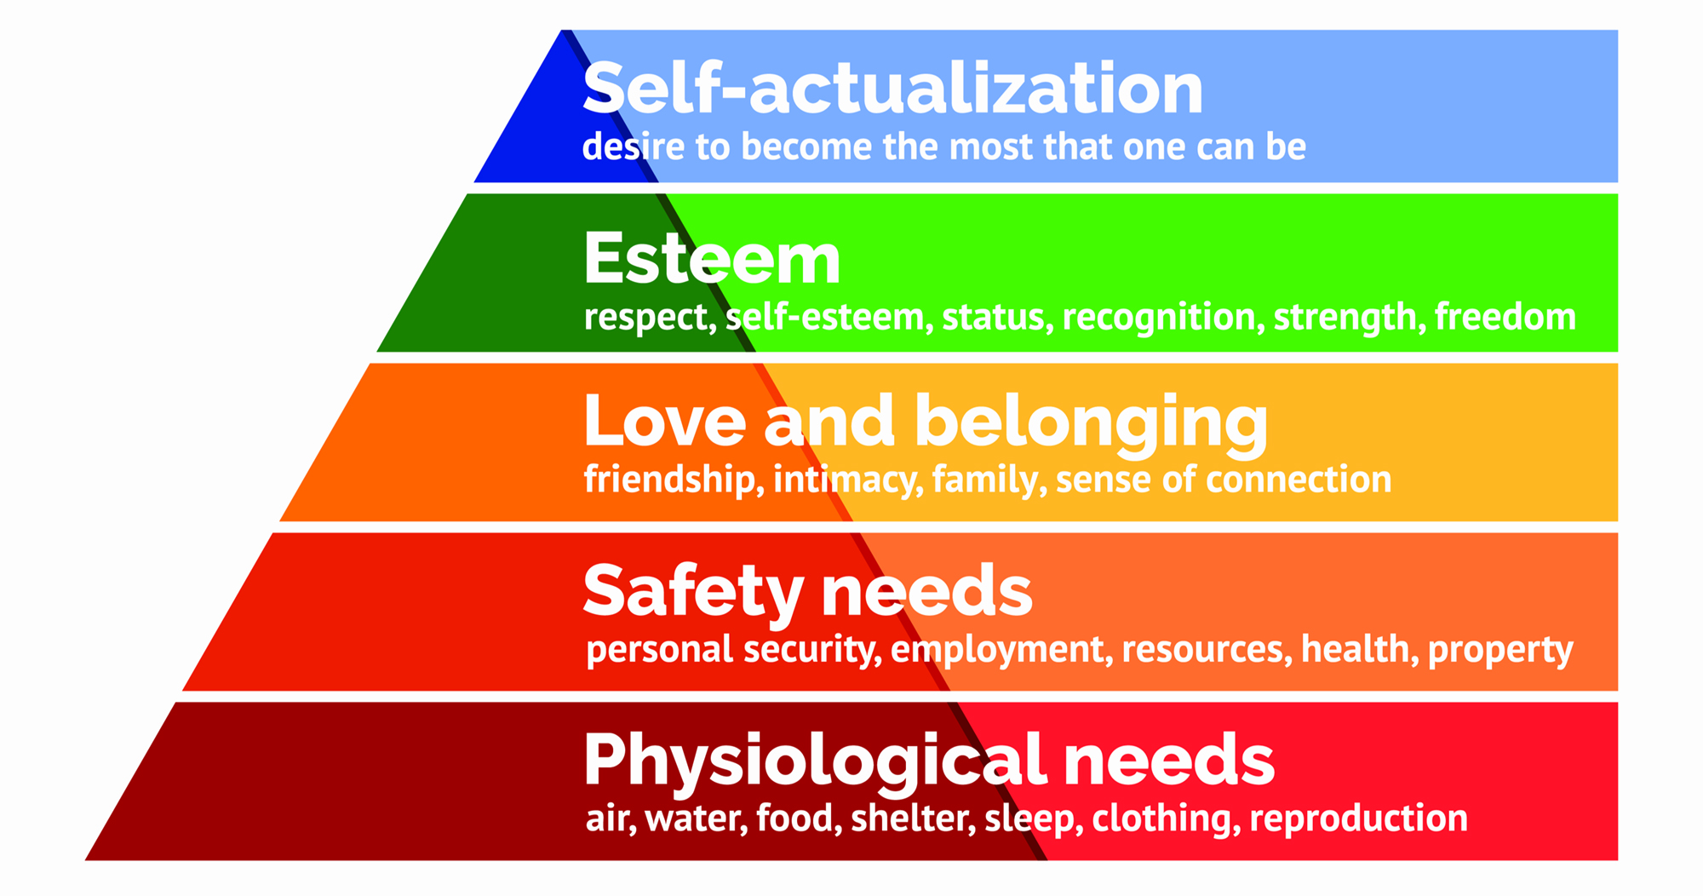
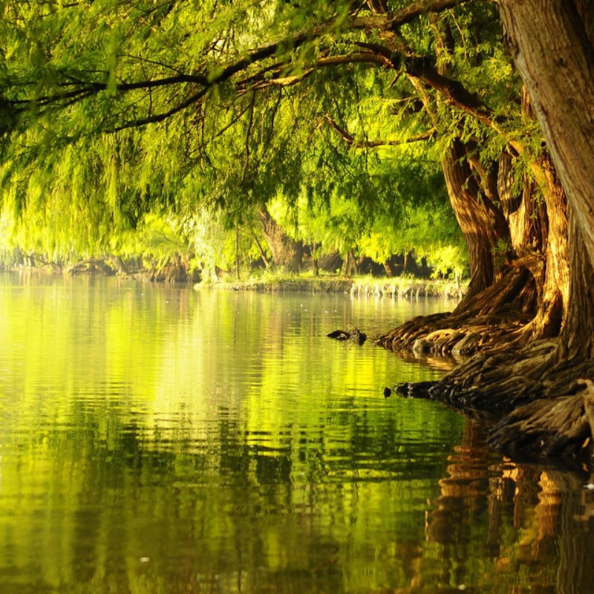

What are these four things and what are we learning about today?

Slide 3

To what extent do two people who have done the same training on the same course with the same lecturers at the same uni and qualified with the same grade end up teaching the same?
Do the differences change if one of you knows Jesus?

Slide 4
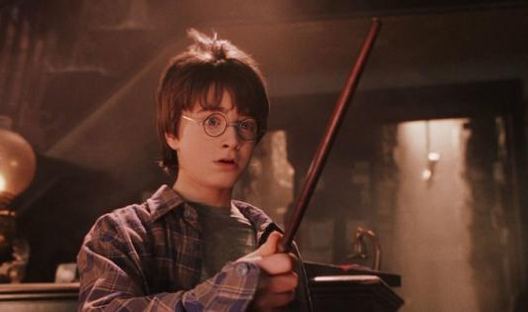
1. Our Different Identity

Slide 5
‘So then, you are no longer strangers and aliens, but you are fellow citizens with the saints and members of the household of God, built on the foundation of the apostles and prophets, Christ Jesus himself being the cornerstone, in whom the whole structure, being joined together, grown into a holy temple in the Lord.’ (Ephesians 2:19-21)

Slide 6
This means that we:
Are for a different purpose in our lives
Answer to a different authority first

Slide 7
2. Our Different Priorities

Slide 8
3. Our Different Supply
‘But blessed is the one who trusts in the Lord,
whose confidence is in him.
They will be like a tree planted by the water
that sends out its roots by the stream.
It does not fear when heat comes;
its leaves are always green.
It has no worries in a year of drought
and never fails to bear fruit.’ (Jeremiah 17:7-8)

Slide 9
What does the Christian have that a non-Christian doesn’t that can help them in teaching?

Slide 10
‘We work hard but not in our own strength. We have times of busyness and find ourselves stretched but always seek to remain centered upon God. We give ourselves unsparingly to people but know how to take care of our own selves well. Living in the rhythms of God’s grace, we find that our lives are like the burning bush – on fire but not consumed.’
(Working from a Place of Rest, Tony Horsfall)

Slide 11
How do we be a bush that doesn’t burn up?
Remain in him
Because he is the source
Because the way in is the way on
How do we do this?

Slide 12
Where does your thinking or believing and living need a change?
What difference could this change make in the next month?

